Slide 1
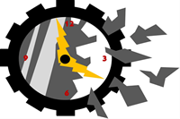
Interfete om-masina
Sistem automat de masurare si monitorizare a energiei electrice
Autori:
Balauca Sergiu
Berciu Radu
Crisan Flaviu
Donca Ionut
Tudor Gligor
Indrumator:
As.dr.ing Sita Ioan Valentin

Slide 2
Descrierea produsului
Scopul acestui proiect a fost masurarea, monitorizarea, respectiv afisarea energiei electrice din diferite medii (apartament),intr-o interfata grafica.
Am incercat sa gasim o solutie cat mai potrivita de optimizare a consului de energie electrica dintr-o incapare, sa gasim “vinovatii” consumului excesiv.
La conceperea acestuia a fost nevoie pe partea de hardware de o placuta Intel Galileo si un senzor de curent, iar la software s-au creat anumite functii necesare pentru citirea, convertirea si afisarea datelor.

Slide 3
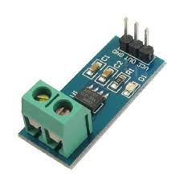
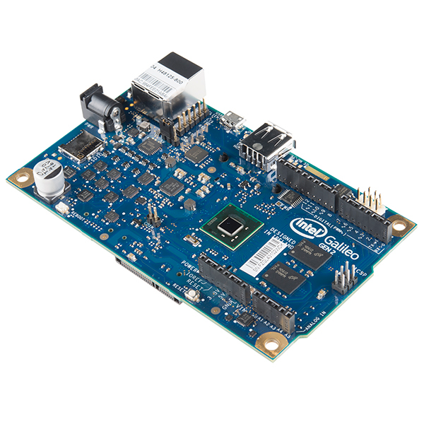
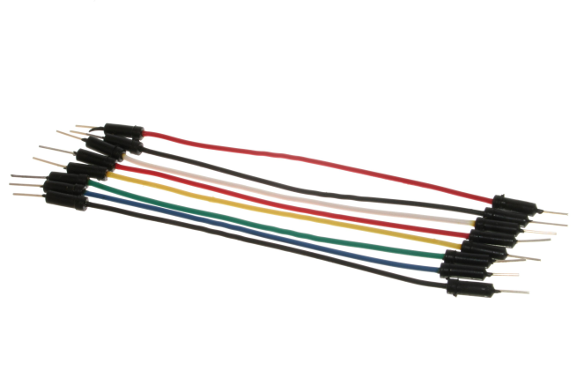
Hardware

Slide 4
Software
S-au creat functii necesare pentru citirea datelor, convertirea acestora si mai apoi afisarea lor intr-o interfata grafica simpla si usor de utilizat.
De asemenea stocarea datelor se va face intr-o baza de date persistenta.
COD ARDUINO
#include <SPI.h>
#include <Ethernet.h>
byte mac[] = {
0xDE, 0xAD, 0xBE, 0xEF, 0xFE, 0xED };
IPAddress ip(192,168,0,17); // asta e adresa asignata
float sensorIn = A5; // Analog input pin on Arduino we connected the SIG pin from sensor
float photocellReading; // Here we will place our reading
double mVperAmp = 66; // use 100 for 20A Module and 185 for 5 Module
double Voltage;
double Voltage2;
double Power;
double VRMS;
double AmpsRMS;

Slide 5
Cod Arduino (continuare)
char server[] = "192.168.0.102";
// Initialize the Ethernet server library
EthernetClient client;
void setup() {
Serial.begin(9600);
Ethernet.begin(mac, ip);
}
void loop() {
Voltage = getVPP();
Voltage2 = Voltage * 80; // asta numai ca sa printez si voltajul pe serial monitor
VRMS = (Voltage/1.0) *0.707; //era initial /2.0
AmpsRMS = (VRMS * 1000)/mVperAmp;
if (client.connect(server, 80)) {
client.print("GET /write_data.php?"); // This
client.print("value="); // This
client.print(AmpsRMS); //We are making a GET request just like we would from our browser but now with live data from the sensor
//client.print("GET /write_data.php?");
client.print("&value2="); //am pus & pt a doua citire
client.print(Voltage2);
Serial.print(AmpsRMS);
Serial.print(Voltage2);
client.println(" HTTP/1.1"); // Part of the GET request
client.println("Host: 192.168.0.102"); // IMPORTANT: find out the IP address of your computer and put it here
client.println("Connection: close"); // Part of the GET request telling the server that we are over transmitting the message
client.println(); // Empty line
client.println(); // Empty line
client.stop(); // Closing connection to server
}
else {
// If Arduino can't connect to the server
Serial.println("--> connection failed\n");
}
// Give the server some time to receive the data and store it. I used 10 seconds here. Be advised when delaying. If u use a short delay, the server might not capture data because of Arduino transmitting new data too soon.
delay(4000);
}

Slide 6
Cod PHP Get Info
<?php
$url=$_SERVER['REQUEST_URI'];
header("Refresh: 5; URL=$url"); // Refresh the webpage every 5 seconds
?>
<html>
<head>
<title>Current Sensor</title>
</head>
<body>
<h1>Current sensor readings</h1>
<table border="2" cellspacing="3" cellpadding="4">
<tr>
<td>ID</td>
<td>TIME</td>
<td>Curent</td>
<td>Tensiune</td>
</tr>
<?php
$con=mysqli_connect("localhost","root","password");
// Retrieve all records and display them
$result = mysqli_query($con,'SELECT id, time, value, value2 FROM testare.sensor ORDER BY id DESC');
while($row = mysqli_fetch_array($result))
{
echo "<tr>";
echo "<td>" . $row['id'] . "</td>";
echo "<td>" . $row['time'] . "</td>";
echo "<td>" . $row['value'] . "</td>";
echo "<td>" . $row['value2'] . "</td>";
echo "</tr>";
}
mysqli_close($con);
?>
</table>
</body>
</html>

Slide 7
Cod PHP Write Data
<?php
$servername = "localhost";
$username = "root";
$password = "password";
$conn = new mysqli($servername, $username, $password);
// Check connection
if ($conn->connect_error) {
die("Connection failed: " . $conn->connect_error);
}
echo "Connected successfully";
$sql = "INSERT INTO testare.sensor (value, value2) VALUES ('".$_GET["value"]."', '".$_GET["value2"]."')";
if ($conn->query($sql) === TRUE) {
echo "New record created successfully";
} else {
echo "Error: " . $sql . "<br>" . $conn->error;
}
?>

Slide 8
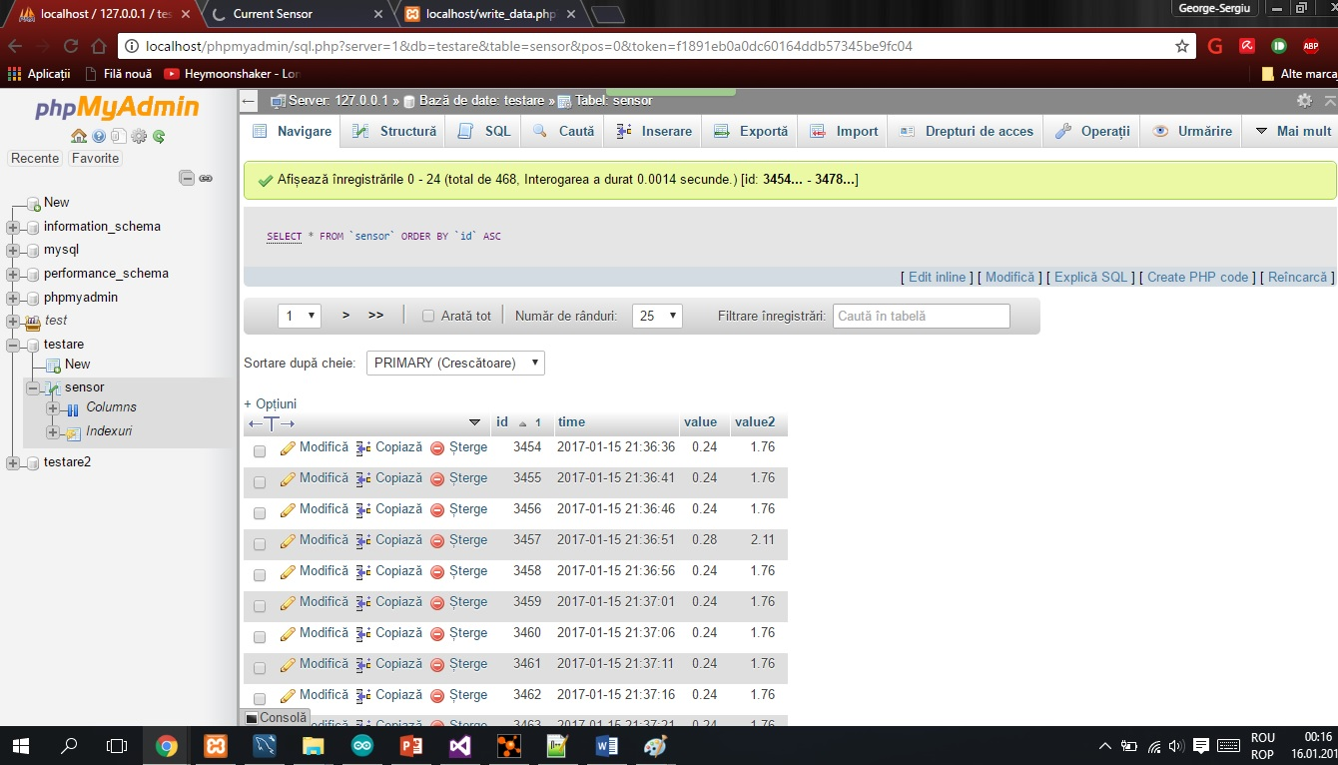
Baza de date
Baza de date creata este una persistenta, folosindu-se SQLManagementStudio. Aceasta este instantiata o singura data, apoi actualizata in anumite perioade de timp.

Slide 9
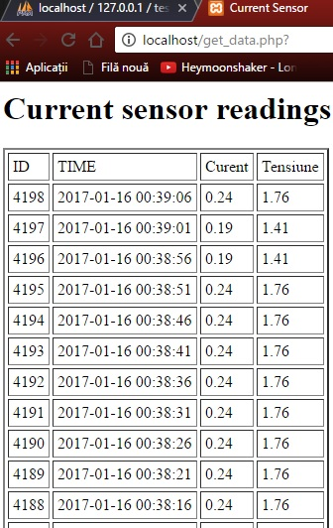
Interfata grafica
Produsul ofera o modalitate usoara si placuta de masurare a energiei electrice in timp ce dispune de o interfata simpla si usor de citit.

Slide 10
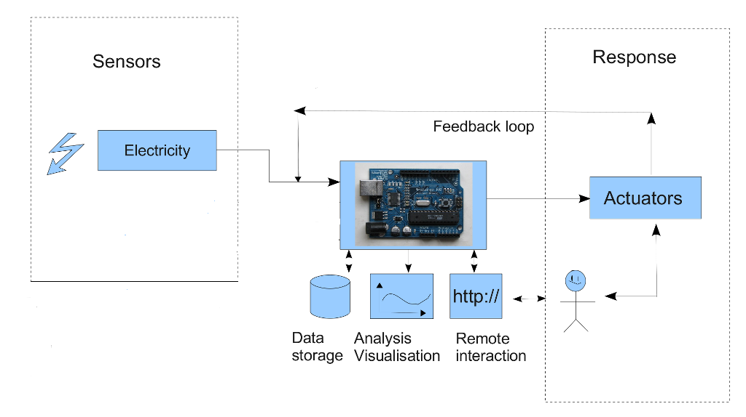
Arhitectura sistemului

Slide 11
Concluzii
Produsul creat se incadreaza intr-un nivel mediu de raport calitate-pret fiind usor si placut de utilizat datorita interfetei grafice si spatiului mic de depozitare.

Slide 12
Bibliografie
1. http://www.w3schools.com/php/php_mysql_insert.asp
2. http://www.instructables.com/id/Save-data-of-temperature-and-humidity-on-MySQL-wit/?ALLSTEPS
3. http://www.tweaking4all.com/hardware/arduino/arduino-ethernet-data-push/
4. http://www.icreateproject.info/uncategorized/arduino-save-data-to-database/
5. http://www.icreateproject.info/uncategorized/arduino-display-data-over-local-network/

